Slide 1
What factors impact our health status?

Slide 2
Maslow’s Hierarchy of Needs
http://goo.gl/ppcRtj
Notes:
http://goo.gl/ppcRtj For original video

Slide 3
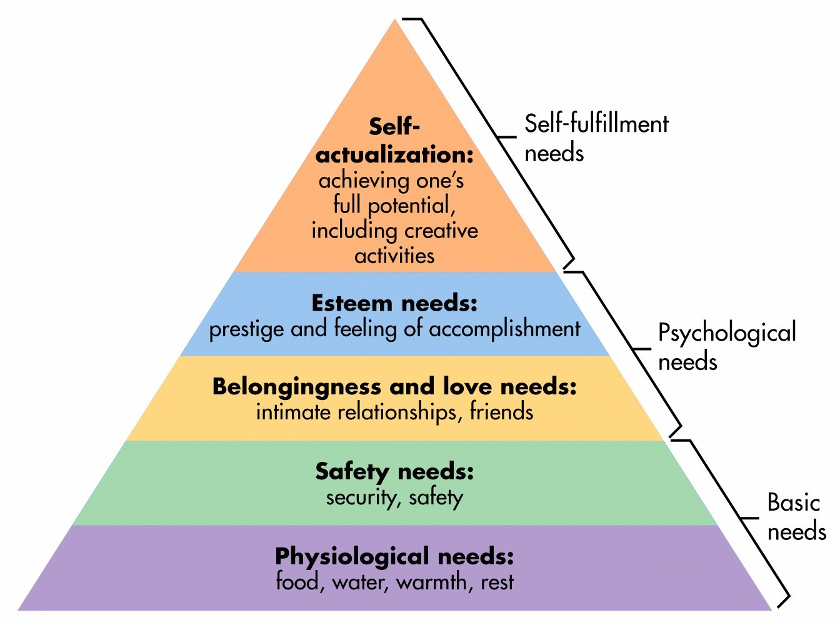
Notes:
This pyramid outlines how people have basic and psychological needs that must be met before they can reach their full potential. Without things like food, shelter and personal relationships we would not be able to pursue creative ventures or develop strong problem solving skills.

Slide 4
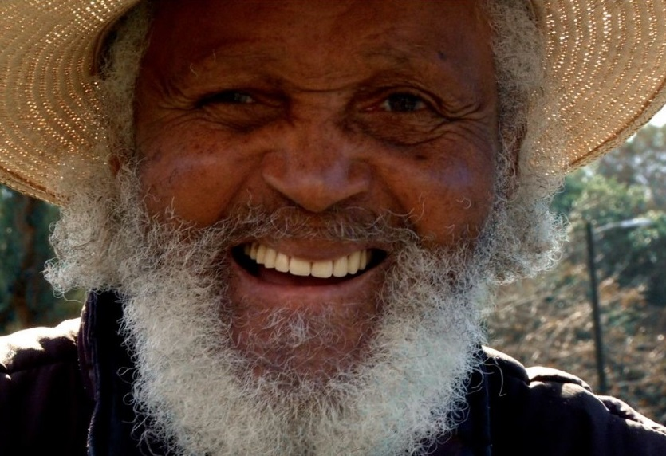
Notes:
It also gives us an insight into some of the factors that impact our overall health.

Slide 5
Income and Social Status
Notes:
How does having income and social status impact our health? What if we don’t have it?

Slide 6
Education
Notes:
What about education? How does education, or lack thereof, affect our health?

Slide 7
Social Support Networks
Friends
Family
Notes:
Does having supportive friends and family change our health status?

Slide 8
Employment and Work Conditions
Notes:
What about having a job or the work conditions in that job?

Slide 9
Social Environments
Notes:
Do our interactions with others impact our health? What if we’re exposed to violence or hatred? Does that impact us even if we’re not directly involved?

Slide 10
Physical Environments
Notes:
Finally, what about the world around us? If we’re in a place that’s less than ideal can we still have a positive health status?

Slide 11
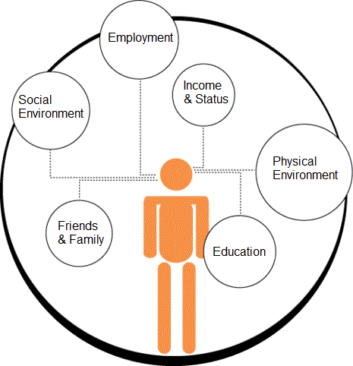
Notes:
Today, you’ll be looking at one of these factors and how it impacts our overall health.

