Slide 1
Chasing the clock
Some examples of poor time management and how they can negatively affect your life

Slide 2
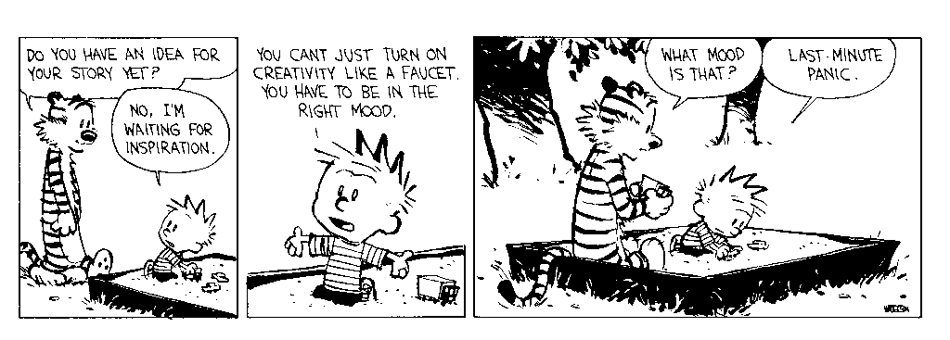
Is this you?
Notes:
Rushing through work to get it done. Some people work well under pressure but many people need time to process information and decide on a plan of action before getting work done

Slide 3

When do you get things done?
Waiting until the last minute can cause problems when something unexpected comes up
What happens when your parents are called into work and you need to watch your siblings?

Slide 4

How do you set priorities?
Video games can be a great way to relieve stress
How much time you spend on them can hurt your ability to get assignments completed
May hurt your relationships with friends and family

Slide 5
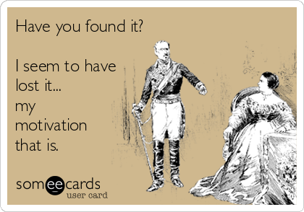
Lacking Energy?
Being constantly behind does catch up with you after a while
Loss of motivation is a big problem when you need to get something done

Slide 6

Looking for perfection?
Spending so much time striving for perfection hurts your ability to get things done
You either never start or go incredibly slowly

Slide 7
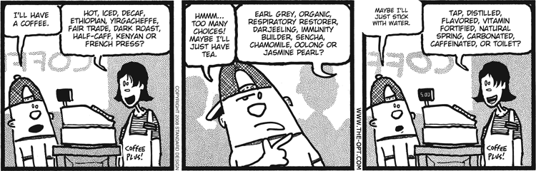
Too Many choices?

Slide 8

Saying YES to Everything?
May sound great to help others (and it is) but saying yes to everyone and everything isn’t realistic
will leave you overworked and too stressed to complete anything meaningful

Slide 9

Doing everything yourself?
You’re risking mental overload
Ask for help when you need it
Don’t try to complete group projects alone – make your partners do their share

Slide 10
instead of always chasing the clock, how can we get better at managing our time?

