Slide 1
Only a Bystander?
When and how do you help someone in need

Slide 2
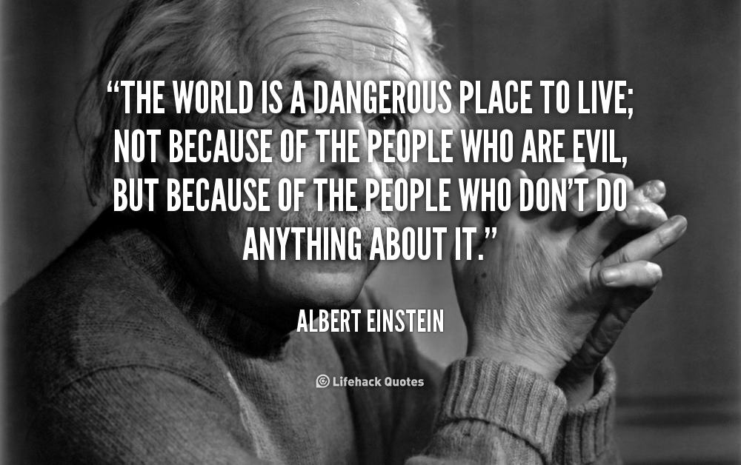
Read this quote and text your initial thoughts into the Today’s Meet room.

Slide 3
What is a bystander?
A person present at an event or incident who is not directly involved
Also called an onlooker, passerby, spectator, witness

Slide 4
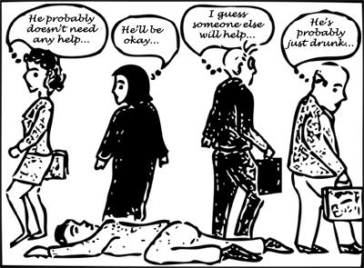
What would you do?

Slide 5
The role of the bystander
In harmful situations, like bullying or harassment, doing nothing makes it look like you think what’s going on is okay
Need to support the victim(s) to show others that their words or actions are not acceptable
Need to help others when they’re in need

Slide 6
So what can you do to help?

Slide 7
Tip #1 – The Fake Friend
Pretend to be the friend of the person being harassed
A safe way to show harassers that their target is not alone in a public place

Slide 8
Tip #2 – Call Out the Harasser
Most people will stop if they’re called out on their actions
Make simple statements like:
“Stop touching them!”
“That’s not ok!”
“Stop harassing them!”

Slide 9
Tip #3 – Make Your Presence Felt
Let the aggressor know that you see, hear and dislike their behavior
Sometimes ringing a doorbell or asking for the time is enough of a distraction to make harassment stop

Slide 10
Tip #4 – Check In with the Target
One question can stop an aggressor because they know someone is watching
Ask the target questions like:
“Are you ok?”
“Do you need help?”
“Is that person bothering you?”

Slide 11
Tip #5 – The Distraction
Create a diversion so the target can get away
Only do this if it is safe to do so
If not safe, call someone for help

Slide 12
Tip #6 – Be a Role Model
Most effective way to stop harassment
If people see you standing up for others, they will learn to do so as well

