Slide 1
Let Me Take An Inner Selfie

Slide 2
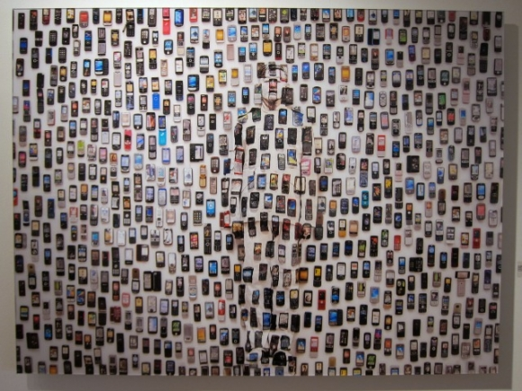

Slide 3
Across the world,
93,000,000
selfies are taken
EVERY SINGLE DAY!

Slide 4
SELFIE
Officially recognized by the Oxford English Dictionary in 2013.
A photograph that one has taken of oneself, typically one taken with a smartphone or webcam and shared via social media.

Slide 5
Not all bad…

Slide 6
…but it’s changing the way we live our day-to-day lives
On average, we check our phones over 100 Billion times per DAY!

Slide 7
People are spending more time connecting through their phones…

Slide 8
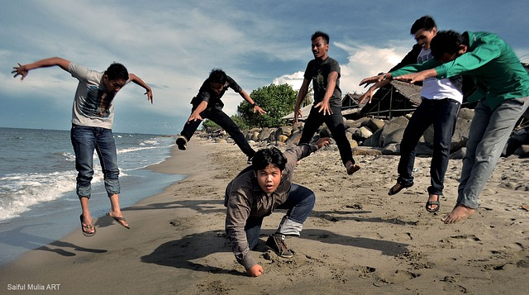
…and less time connecting on a personal level

Slide 9
So…who really knows you?
Not just your name
Or your friend’s names
Or where you go to school

Slide 10
Who really knows what makes you tick?

Slide 11
What do you value most in life?

Slide 12
What are your beliefs?

Slide 13
What would your inner selfie look like?
Today, we’re going to find out.

