Slide 1
How do we communicate?
A look at the 3 V’s and how technology is changing our ability to communicate effectively

Slide 2
Have you been told this before?

Slide 3
Well, it’s completely true
Notes:
Albert Mehrabian tells us that when communicating, only 7% comes from our words. The other 93% is a combination of tone and body language.

Slide 4
So, it’s not just what we say, it’s how we say it and how we look when we say it too.

Slide 5
Example: “That’s great!”
Notes:
Happy for you like Felix or sarcastic in tone like the cheshire cat

Slide 6
Visual
Posture
Gestures
Clothing
Facial expressions

Slide 7
Vocal
Quality tells us if we want to listen
Voices that are high-pitched, whining, breathy, harsh, or loud are less likely to be heard over rich and resonant voices.

Slide 8
Verbal
Content is always critical when communicating

Slide 9
All 3 aspects must work together for effective communication.

Slide 10
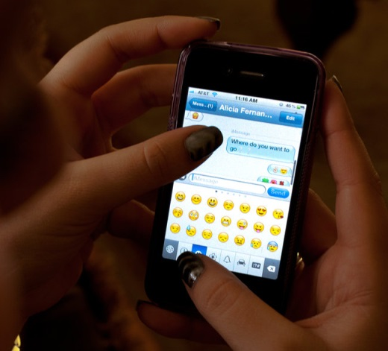
Technology is limiting our use of the 3“V’s”.

Slide 11
How can we work to improve our communication skills so they are both effective and assertive?

