Slide 1
Getting Active for a Healthier You

Slide 2
What is physical activity?
Movement that increases your heart rate and breathing
Any movement that has you using more of your body’s energy

Slide 3
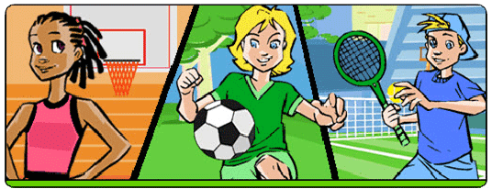
Why should you be physically active?
Improve, or maintain, your health and fitness level
Gain self-confidence
Do better in school
Grow stronger
Have fun with friends
Feel happier
Learn new skills

Slide 4
What does it look like for you?
60 minutes of moderate- to vigorous- intensity physical activity daily
Vigorous intensity at least 3 days per week
Strengthen muscle and bone at least 3 days per week

Slide 5
What’s the difference in intensity levels?
Moderate
Vigorous
You’ll sweat a little and breathe harder
You could talk, but not sing a song without stopping for breath
i.e. skating, bike riding, dancing, brisk walking
You’ll sweat a lot and be out of breath
You couldn’t say more than a few words without stopping for breath
i.e. running, rollerblading, competitive sports

Slide 6
