Slide 1
Gambling
What it is and some statistics about Nova Scotia

Slide 2
Have you ever….
…played any games for Keepsies? (i.e. Trading cards, marbles, crazy bones)
…played these games for fun, but not money?
Dominoes
Monopoly
Trouble
Card games
Games of Skill (i.e. bowling, playing pool, shooting hoops)

Slide 3
Have you ever played any of these games for money?
Bingo
Dominoes
Dice
Lottery tickets
Scratch tickets
Games of Skill (i.e. bowling, playing pool, shooting hoops)
Pull Tabs
Cards
Sporting events
Slot machines
Pro-Line or other sport lotteries

Slide 4
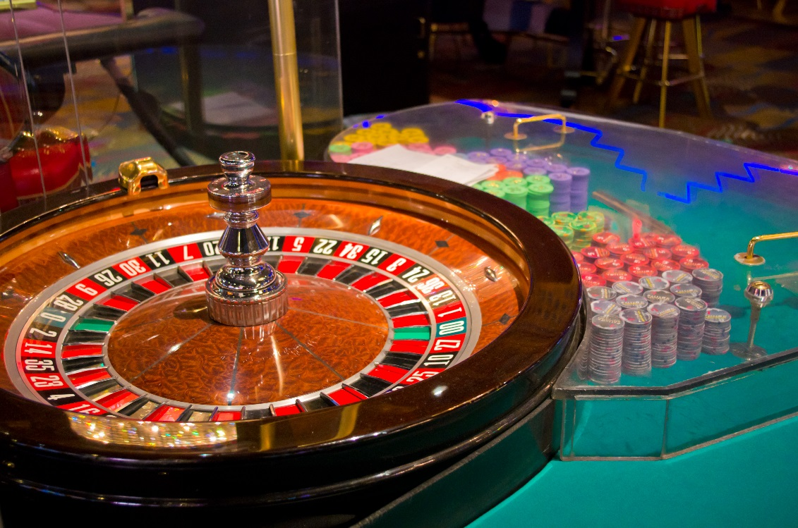
If you said YES to any of the questions, you have gambled.
Notes:
Many youth believe that because they haven’t been to casinos or racetracks that they haven’t gambled, but it’s simply not true.

Slide 5
What is Gambling?
Gambling means risking something of value (like money, cell phone, iPad, Jordans, etc.) on an event where you don’t know the outcome.
There is a chance you could win but there is an equal, if not greater, chance that you will lose.

Slide 6
Who Gambles?
About 87% of Nova Scotians report gambling at least once a year.
Of those, 93% do so for fun and don’t have any problems.
On average, adults in Nova Scotia spend $609/year gambling.
Notes:
According to 2007 study

Slide 7
Is Gambling a Problem?
According to the Canadian Problem Gambling Index (CPGI):
About 0.9% of the population (7000 Nova Scotians) have a problem gambling
Another 1.6% (about 12000 people) are considered at moderate risk to develop a gambling problem.

Slide 8
Statistics only tell so much…
The problem with stats is that they only look at legally sanctioned activities.
There is no accountability for private gambling, like weekly poker games, a friendly wager on a hockey game, or who’ll win Best Picture at the Oscars this year.

