Slide 1
Notes:
Traditional expectation.

Slide 2
Notes:
However…not always the case. Sometimes we find ourselves in situations we never considered.

Slide 3
“Having a baby is one of the most wonderful things in your life, as well as the hardest thing in your life.”
Nuno Bettencourt
Notes:
Read quote. Emphasize the importance of recognizing it is hardest thing although rewarding in so many ways.

Slide 4
What can you do?
Notes:
Move through next 3 slides quickly as options…abortion, adoption, or keep the baby. How do you decide?

Slide 7
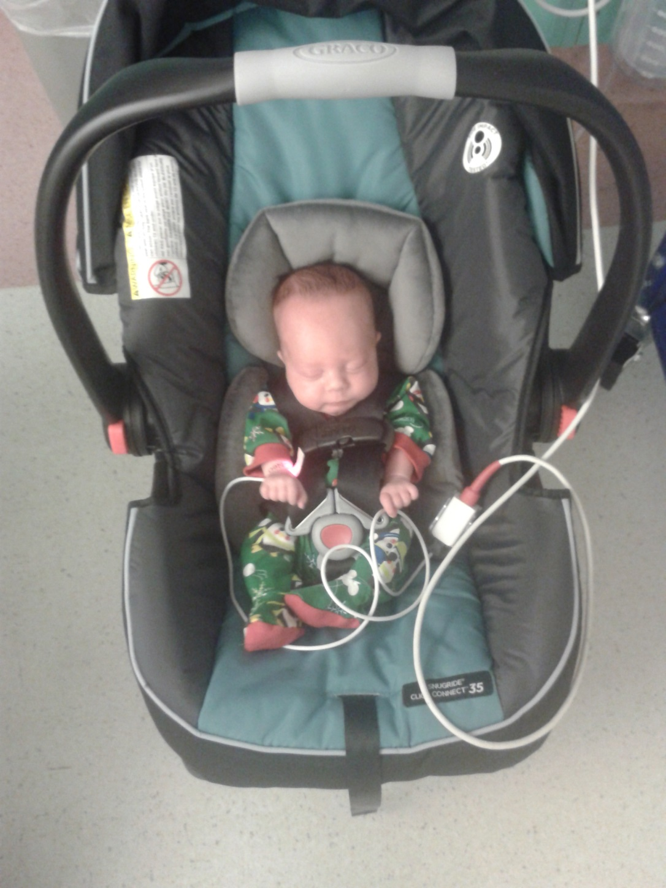

Slide 8
Multiple Choice
Make a decision that will impact you for the rest of your life.
A – Abortion
B – Adoption
C – Keep the baby
Notes:
Not a simple multiple choice test when it’s a baby we’re talking about

Slide 9
What about the father?
Notes:
One person often left out of media and discussions is the teen father. What part does he play? Is his input important? Should it be?

Slide 10
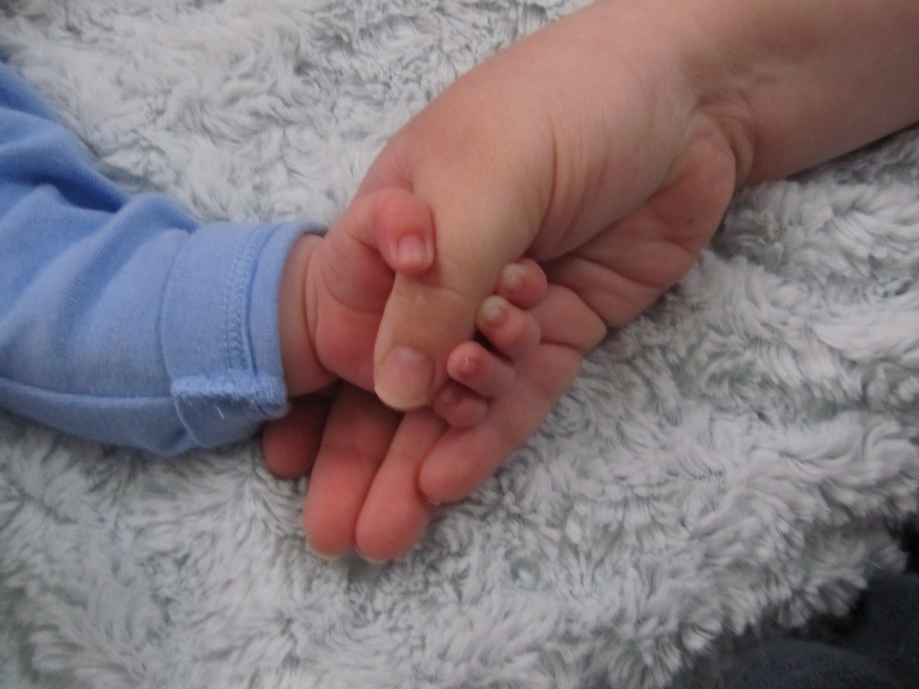
Notes:
Is anyone ever truly ready to have someone completely depend on them?

Slide 11
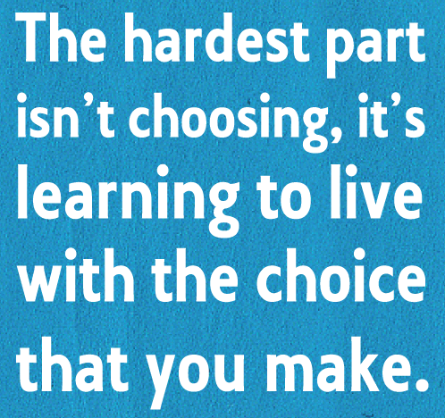
Notes:
Once the decision is made there is very little, if any, room for changing your mind. You need to be sure it’s the right decision for you.

Slide 12
What can you do if you’re 14 and pregnant?
Notes:
Driving question of the assignment.

